Slide 1
Web Application Tool Time
Cybersecurity
Lesson 14.3

Slide 2
Class Objectives
By the end of today’s lesson, you’ll be able to:
Identify ways in which web application security tools can assist with testing security vulnerabilities.
1
Configure Burp Suite and FoxyProxy to capture and analyze an HTTP request.
2
3
Identify session management vulnerabilities using the Burp Suite Repeater function.
Conduct a brute-force attack against a web application login page with the Burp Intruder function.
4

Slide 3

Attacking Web Applications
Using Security Tools

Slide 5




Last Lesson
Web applications use back-end components to apply business logic to the application. Back-end components can provide file structure, content management, and access control, and include back-end languages such as PHP and Java.
Back-end component vulnerabilities exist within the back-end components of web application servers.

Slide 6

Last Lesson
Directory
Traversal
A web app back-end component vulnerability in which an attacker accesses files and directories from a web application outside
a user’s authorized permissions.
Local File Inclusion (LFI)
Another web app back-end component vulnerability in which
an attacker tricks
the application into running unintended back-end code or scripts that
are LOCAL to
the application’s filesystem.
Remote File Inclusion (RFI)
A third web app back-end component vulnerability in which an attacker tricks
the application into running unintended back-end code or scripts that are REMOTE to the application’s filesystem.
Directory traversal, LFI, and RFI all fall under the OWASP Top 10 risk broken
access control.

Slide 7
Restrictions on what authenticated users are allowed to do are often not properly enforced.
Attackers can exploit these flaws to access unauthorized functionality and/or data, such as access other users’ accounts, view sensitive files, modify other users’ data, change access rights, etc.”
OWASP explains broken access control as follows:
Source: owasp.org

Slide 8


Today’s Lesson
Web application security tools can assist security professionals by automating testing processes.
When we first executed SQL injection attacks, we were successful after our first payload attempt of:
‘jsmith’ OR '1' = '1’
Realistically, we may need to test many different payloads, such as:
"jsmith" or true--
jsmith OR "1" = "1"
jsmith -- OR '1' = '1'
'jsmith') or true--
Notes:
shutterstock_1177007617

Slide 9





Today’s Lesson
We will use Burp Suite, a popular web application security tool, to automate processes as well as capture, display, and modify web app requests and responses, and use other built-in features to test for vulnerabilities.
https://...
GET/my account Host:...
00110001110001
11001000111001
00110001110001
11001000111001
Browser
Burp Suite
Website
Source: portswigger.net

Slide 10
While demonstrating Burp Suite, we will explore vulnerabilities that fall under the OWASP Top 10 risk of identification and authentication failures.
A01
Broken Access Control
A06
Vulnerable and Outdated Components
A02
Cryptographic Failures
A07
Identification and Authentication Failures
A03
Injection
A08
Software and
Data Integrity Failures
A04
Insecure Design
A09
Security Logging and
Monitoring Failures
A05
Security Misconfiguration
A10
Server-Side Request Forgery (SSRF)
Source: owasp.org

Slide 11
Identification and authentication failures are risks that permit an attacker to either access or bypass the authentication methods that are used by a web application.

Slide 12
Today’s Lesson
The lesson will proceed as follows:
01
02
03
We will begin by introducing Burp Suite and FoxyProxy and learn how to configure them to capture and analyze HTTP requests and responses.
Then we will learn how to use the Burp Repeater feature to determine session hijacking vulnerabilities.
Lastly, we will show how to use the Burp Intruder feature to conduct an automated brute-force attack.

Slide 13
⚠️ Important ⚠️
The techniques we will learn throughout this unit can be used to cause serious damage to an organization’s systems.
This is ILLEGAL when done without permission. All of the labs that we provide are safe locations to test the methods and tools taught during the week.
NEVER apply any of these methods to any web applications that you do not own or do not have clear, written permission to be interacting with.

Slide 14
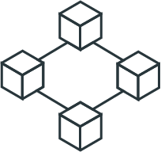
Introduction to
Web Proxies and Burp Suite

Slide 15
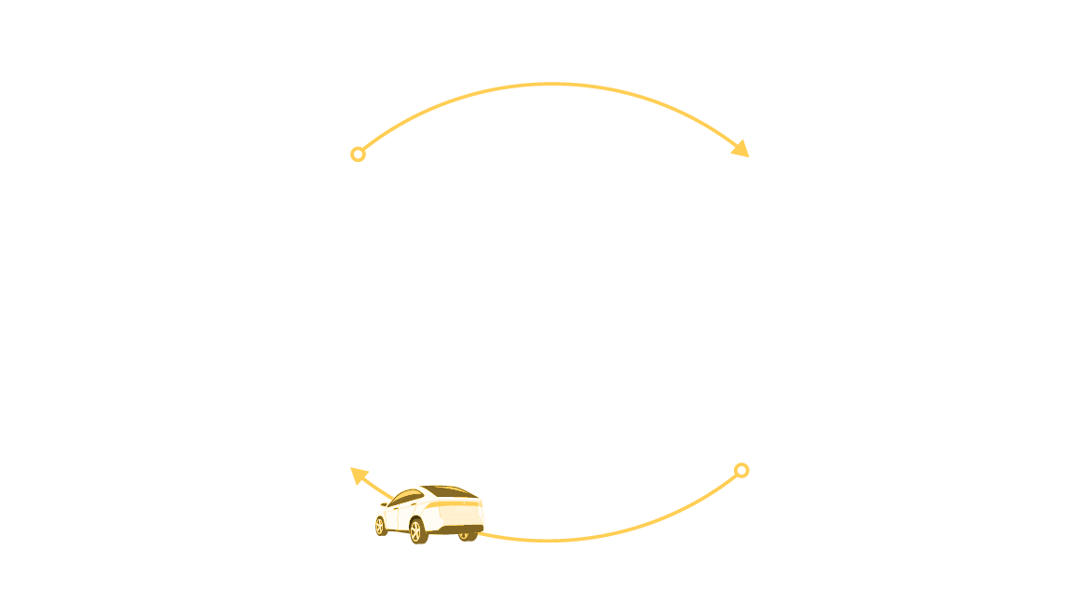
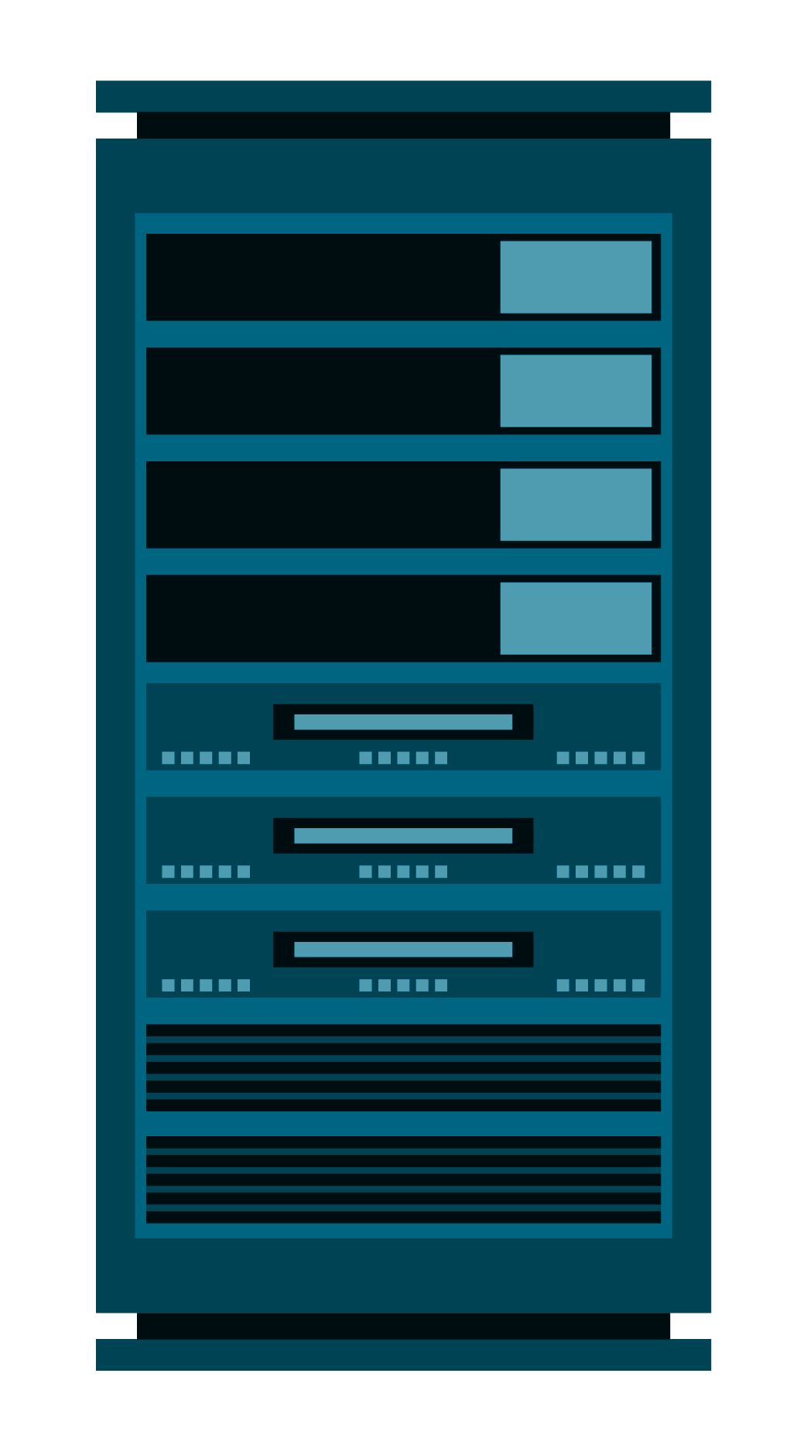
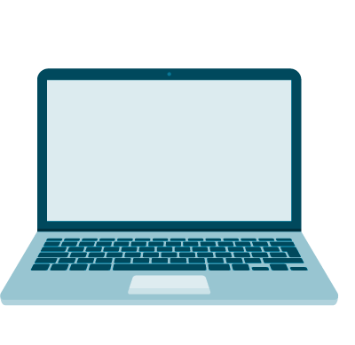

How Web Apps Interact with Back-End Servers
01
A user’s browser
(the client) requests
an image of a car to
be displayed with an HTTP request.
HTTP Request
for Car Image
02
The web server (the server) responds with
the car image by sending an HTTP response.
03
The browser receives the HTTP response and renders the image of the car to the user.
HTTP Response
Notes:
Car: shutterstock1459757000

Slide 16
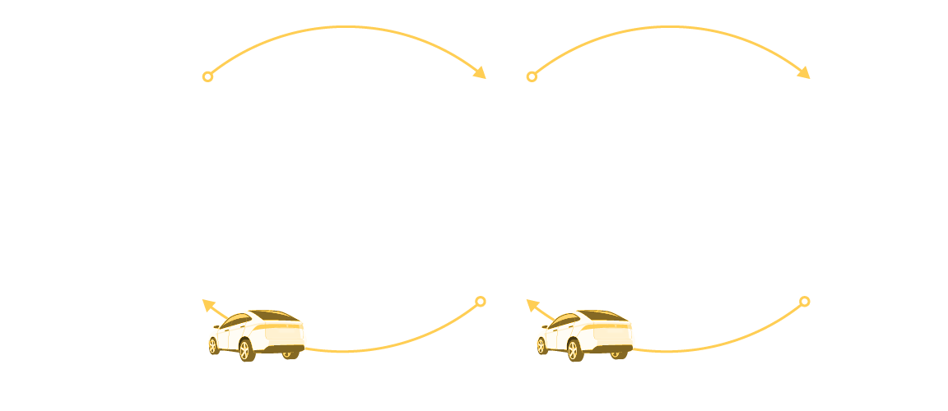
Web Proxy
A web proxy is an intermediary between the client and the server.
Internet traffic flows through the proxy on the way to its intended destination.
HTTP Request
for Car Image
HTTP Request
for Car Image
Proxy
HTTP Response
HTTP Response

Slide 17


Web Proxy
Web proxies can be used by:
Organizations
Individuals
To monitor and block harmful web traffic as some web proxies can be configured to block specific websites.
To provide anonymity when using the internet as some web proxies can change the source IP address.

Slide 18
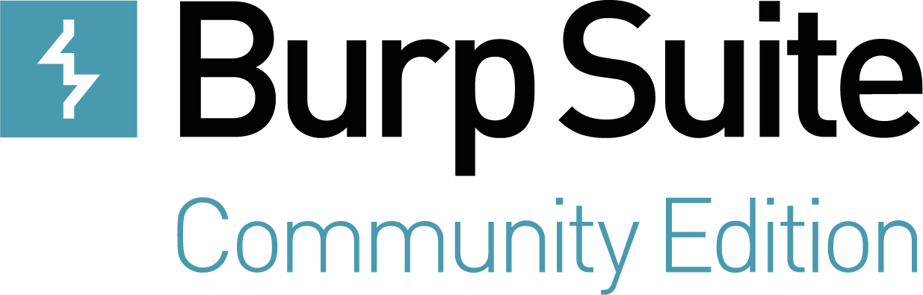
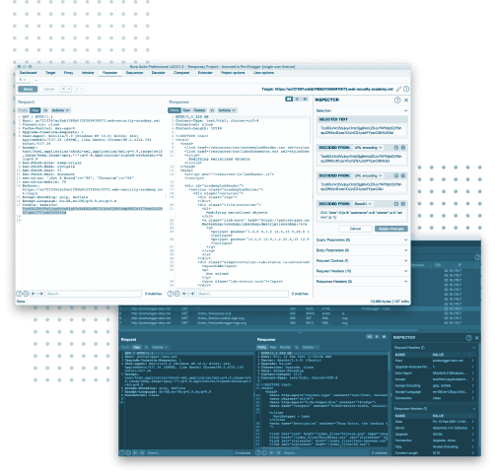
Burp Suite
Burp Suite is a web application security tool that lies between your browser and your target application.
Burp Suite intercepts raw HTTP traffic either from the browser or the server,
thus functioning as a web proxy.
Burp has many additional features
and capabilities that allow a security professional to analyze, modify, and automate the HTTP traffic before
passing it along to its final destination.
(portswigger.net)

Slide 19
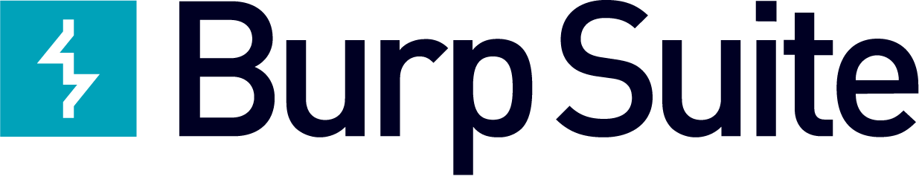

Burp Suite Demo
In the following demo, we will:
01
Start and access .
02
Navigate Burp Suite.
03
Configure the proxy on Burp Suite.
04
Configure the proxy on your browser.
05
Enable FoxyProxy to send traffic to Burp Suite.
06
Review the captured traffic on Burp Suite.

Slide 20
Burp Suite

Slide 22
Configuring Burp Suite
In this activity, you’ll configure Burp Suite proxy settings in order to prepare for a future session hijacking attempt.
20 minutes

Slide 23
Notes:
04. Instructor Review: Configuring Burp Suite Review (0:10)

Slide 25

Session Management
Vulnerabilities

Slide 26
Session Management Vulnerabilities
We will learn how
to use a Burp Suite feature called Repeater to test for session management vulnerabilities.
Before we start
using Burp Suite,
we will revisit how applications use cookies to manage
a user’s session.

Slide 27

Remember
HTTP resources are inherently stateless, meaning that whenever your browser requests a webpage, there is no way for that webpage to distinguish you from anyone else.

Slide 28
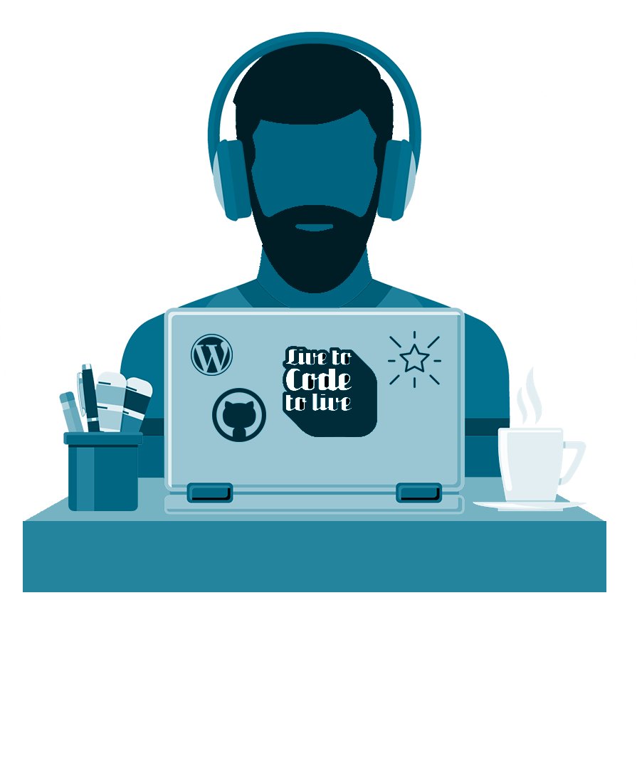

Session Management and Cookies
Websites need a way to deliver content that is specific to each user.
To do so, they establish sessions by using cookies.
Sessions
Cookies
Unique server-side sets of user data that are used to customize webpages for the specific user accessing them.
Small pieces of text data that, when sent by an HTTP server’s response header, are saved by the user’s HTTP client.

Slide 29

Session Hijacking
While using session cookies is intended to keep a state between webpages when a user accesses a web application, a malicious user can obtain another user’s unique session cookie and hijack the user’s private session.
This is an example of session hijacking. Remember, we conducted a session hijacking
attack when we used the Chrome browser
extension Cookie-Editor to swap sessions.
Notes:
Image source: shutterstock_702250606

Slide 30
Session hijacking falls under the OWASP Top 10 risk of identification and authentication failures because if an attacker has access to a user’s session, they can bypass the application’s authentication measures.
A01
Broken Access Control
A06
Vulnerable and Outdated Components
A02
Cryptographic Failures
A07
Identification and Authentication Failures
A03
Injection
A08
Software and
Data Integrity Failures
A04
Insecure Design
A09
Security Logging and
Monitoring Failures
A05
Security Misconfiguration
A10
Server-Side Request Forgery (SSRF)

Slide 31
Session Hijacking Methods
Sniffing Traffic | If a malicious user can sniff unencrypted traffic, then they can potentially capture the session cookie and take over a user’s session.
Client-Side Attacks | A malicious user can deploy a cross-site scripting attack to steal a user’s session cookie.
Predictable Sessions | A malicious user can predict what a unique session cookie might be.

Slide 32



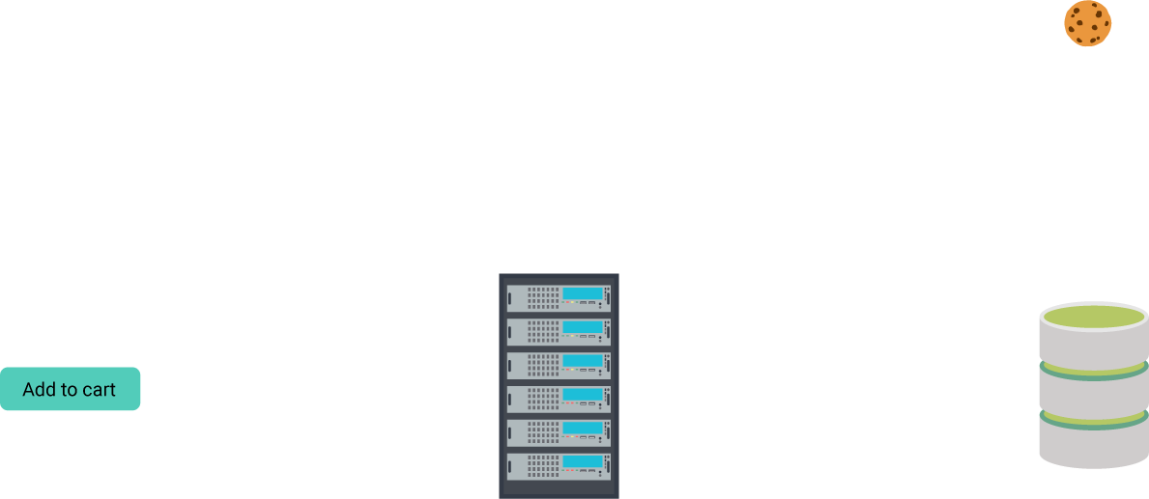
Predictable Session Scenario
Henry, a malicious user, is using a stock-trading website to buy and sell stocks and mutual funds.
Henry logs in with their own credentials on Monday, October 28, 2024, to the stock-trading site, then checks their session cookie in their
browser settings:
Henry logs out and immediately logs back in again with their own credentials, then checks their session cookie again:
Henry logs in the following day—Tuesday, October 29, 2024—and their session cookie is now:
102824MON-1454
102824MON-1455
102924TUE-3834

Slide 33
Predictable Session Scenario
By examining the session cookies that were generated, Henry can determine that the algorithm used by the stock-trading site likely comprises the following:
102824MON-1455
Date
Day of the week
4 digit incrementing number

Slide 34


Predictable Session Scenario
By figuring out the algorithm, Henry can try and guess another user’s session cookie, then hijack another user’s session.
Eventually, after many tries,
Henry tries the session cookie:
Henry might
first try:
103024WED-1111
103024WED-1118
If that didn’t work,
they could try:
103024WED-1112
They end up inside the stock-trading account of another user, Julie Jones.
If that didn’t work,
they could try:
103024WED-1113
If that didn’t work,
they could try:
103024WED-1114

Slide 35
Predictable Session Scenario
In this scenario:
01
02
03
The session management vulnerability was that the session cookie was predictable.
Henry exploited the vulnerability by conducting a session hijacking attack, using a predicted session cookie to hijack Julie Jones’
private session.
Note that Henry had to log out and log back in again to determine the pattern of the session cookies. This manual process can be time-consuming and inefficient.

Slide 37

Analyzing Session
Management Vulnerabilities
with Burp Repeater

Slide 38
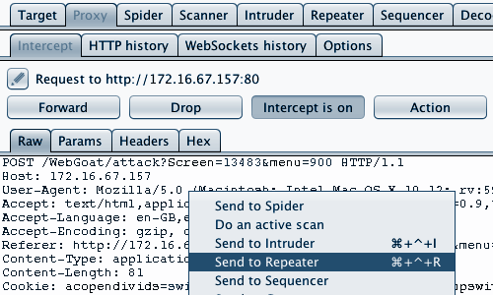
Burp Repeater
Burp Repeater can simplify the process detailed in the previous scenario
by using an algorithm to generate session cookies.
Source: portswigger.net

Slide 39
Burp Repeater Demo
In this demonstration, we will continue to work on Replicants’ web application
and complete the following steps:
01
Access the session cookie generator and enable proxy settings.
02
Generate and review the session cookie.
03
Move the HTTP request to Burp Repeater.
04
Use Burp Repeater to review the HTTP response.

Slide 40
Burp Repeater

Slide 41

Real-World Challenges,
Impact, and Mitigations

Slide 42
Real-World Challenges
While this demo illustrated how to determine session management vulnerabilities with the Burp Repeater feature, in the real world, we also need to be aware of several issues that we did not cover.
Generation of Session Cookies
Use of Burp Repeater
While we clicked a button to generate session cookies, real applications do not have a “generate” button.
Most web applications generate the session cookie on successful authentication into the web application.
Security professionals have to determine the HTTP request that generates the session cookie and
use that request in Burp Repeater.
While we used Burp Repeater to simply reissue the same HTTP request, Burp Repeater can be used to modify the request one at a time.
On the HTTP Request panel, an attacker can simply change any data in the request to check how it changes the response.
Attackers can use this to try attacks against different hosts, resources, and types of HTTP requests.

Slide 43

Impact
The reason that session hijacking is considered harmful is due to the impact that it can have.
If a malicious actor can successfully launch
a session hijacking against a web application’s users, they can potentially:
1
View a user’s confidential data.
Use features that are not intended to be accessed by unauthorized users within
a secure application.
2

Slide 44
Mitigation Methods
To mitigate against:
Sniffing Attacks
Client-Side Attacks
Predictable Sessions
The application’s web developer can:
Use an HTTP header to have a Secure cookie attribute.
Use an HTTP header to have an HttpOnly cookie attribute.
Prevent the generated session cookie from being predicted
or brute-forced.
This ensures that:
The client only sends the session cookie encrypted, and it cannot be exposed in the web traffic.
The client does not allow scripts, such as JavaScript, to access the session cookie.
This can protect against a cross-site scripting attack trying to steal
a cookie.
The cookie is long enough to make it difficult to brute force.
The cookie is random enough to be unpredictable.
The cookie doesn’t contain any details about the user.

Slide 45
Session Management Vulnerability Summary
Intended purpose of original function | Session cookies are intended to maintain a user’s session within a web application.
Vulnerability and method of exploit | With a session management vulnerability such as a predictable session, an attacker could predict a future session cookie and conduct a session hijacking attack.
Unintended consequence of the exploit | The unintended consequence is that if an attacker determines a user’s session cookie, they can access the user’s private session.
Mitigation of the vulnerability | Mitigations can vary depending on the session management vulnerability you are protecting against. Mitigations can include using protective HTTP headers and generating session cookies that are difficult to predict.
Potential impact of the exploit | The impact could include viewing a user’s confidential data within the application or conducting unauthorized activities within the application.

Slide 47
Analyzing session management vulnerabilities with Burp Repeater
In this activity, you will use Burp Suite to analyze session IDs that are generated from your application and determine whether they
are randomly generated and thus at risk of session hijacking.
20 minutes

Slide 48
Notes:
08. Instructor Review: Analyzing Session Management Vulnerabilities with Burp Repeater (0:10)

Slide 51

Conducting Brute-Force Attacks with Burp Intruder

Slide 52
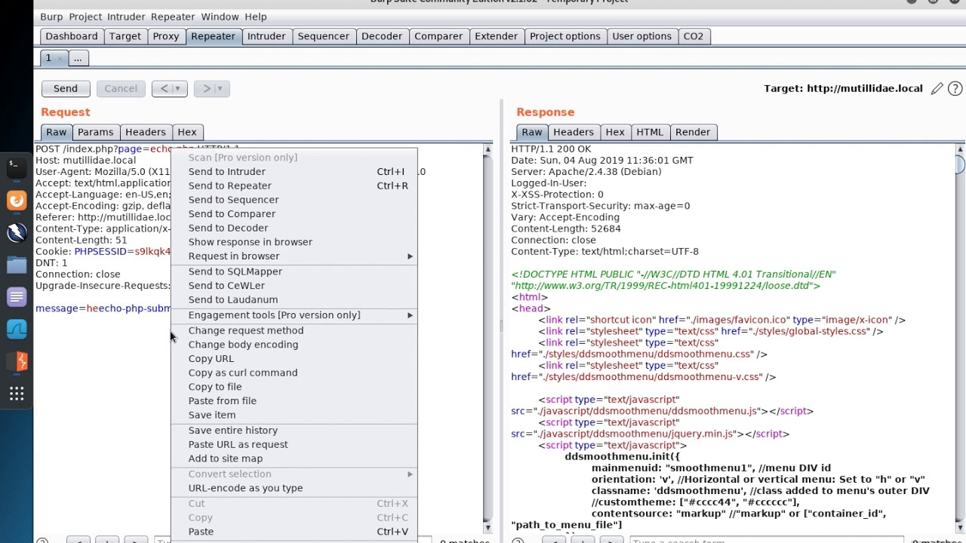
Conducting Brute-Force Attacks with Burp Intruder
Burp Repeater is limited to reissuing individual HTTP messages.
Sometimes it is useful to issue multiple HTTP messages and automate multiple HTTP messages with
a single request.
Source: portswigger.net

Slide 53
Scenario
An attacker is trying to attack a web application form field with a SQL injection attack.
The attacker attempts
a SQL injection attack
with the common payload of:
' OR '1' = '1
Unfortunately for the attacker, the common payload
' OR '1' = '1
doesn’t work.
The attacker now wants
to try many different payloads, such as:
* ' or "
-- or #
' OR '1
' OR 1 -- -
" OR "" = "
" OR 1 = 1 -- -
' OR '' = '
Rather than trying this list one at a time and checking the results individually, it would be more efficient for the attacker to use a tool to try all of these payloads with a single request.

Slide 54
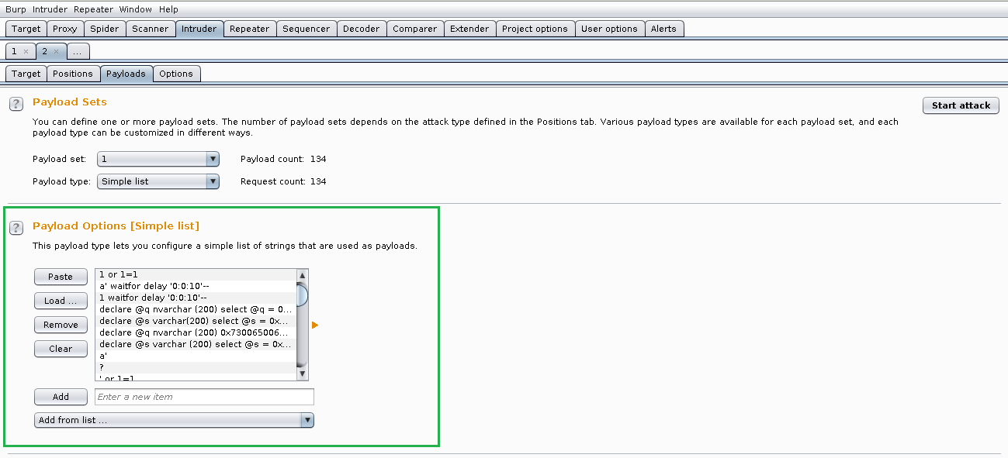
Burp Intruder
Burp Intruder can automate issuing multiple HTTP messages.
It can also provide an understandable summary of the results of the different payloads.
Source: portswigger.net

Slide 55
We will demonstrate
Burp Intruder by conducting a brute-force attack against a web application’s login page.

Slide 56
A brute-force attack is defined
as systematically attempting many passwords or username/password combinations with the hope of determining the correct result to obtain access in an unauthorized area.

Slide 57
Brute-Force Attacks
Other variations of brute-force attacks include:
Credential Stuffing
Password Spraying
Using lists of usernames to conduct brute-force attacks that were obtained from breaches of other websites.
Using a single weak password, such as “123456,” against a large list of usernames.
Brute-force attacks also fall under the OWASP Top 10 risk of identification and authentication failures, as the attacker aims
to bypass an application’s method to securely authenticate a user.

Slide 58

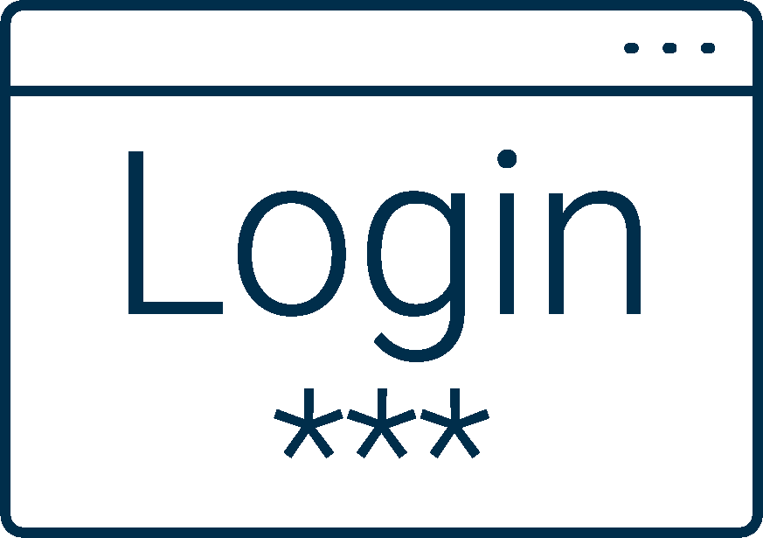
Brute-Force Attacks
An attacker can use a brute-force attack to continuously attempt username and password combinations.
Username: bob@bbb.com Password: Love
Username: bob@bbb.com Password: Love123
Username: bob@bbb.com Password: Love123!
Username: bob@bbb.com Password: L@ve123
Password Dictionary

Slide 59
Burp Intruder Demonstration
In the following demonstration, we will:
Access Replicants’ administrator login page and enable proxy settings.
Generate and display a login request.
Move the HTTP request to Burp Intruder.
Identify the payload positions.
Update the intruder payloads.
Launch the brute-force attack and analyze the results.

Slide 60
Burp Intruder

Slide 61
Real-World Challenges,
Impact, and Mitigations

Slide 62



Real-World Challenges
Uses of Burp Intruder
While we used Burp Intruder to test
a small list of two users and two passwords, most brute-force tests would include much larger lists.
We used Burp Intruder to conduct a brute-force attack, but Burp Intruder can be used to conduct a variety of other web application attacks that test different payloads and payload combinations.

Slide 63
Impact
If a malicious actor can successfully launch a brute-force attack against a web application’s users and gain access to users’ accounts, they can do the following:
01
View a user’s confidential data.
Use features within a secure application
that are not intended to be accessed by unauthorized users.
02
Notes:
shutterstock_1215303871

Slide 64
Mitigation Methods
Developers can use several mitigation methods to protect against a brute-force attack:
01
02
03
Require complex usernames and passwords.
Lock out accounts after a number of failed attempts.
Use multi-factor authentication (MFA).
For example:
Require the user to include special characters, upper- and lowercase, and numbers in the username and password.
After three failed login attempts, the user’s account gets locked.
Require the user to have a password and a secondary form of authentication, like a pin generated by an external token.

Slide 65
Brute-Force Attack Summary
Intended purpose of original function | Web applications use username and password input fields to authenticate a user before they can access a secure part of a web application.
Vulnerability and method of exploit | Without proper protections on the login page, an attacker can apply a brute-force attack to systematically test many user/password combinations to attempt to gain access to unauthorized accounts.
Unintended consequence of the exploit | The unintended consequence is that if an attacker can determine a correct username/password combination, they can access an account that they do not have permission to access.
Mitigation of the vulnerability | Mitigations can include requiring complex usernames and passwords, using MFA, and enabling a lockout after a certain amount of failed login attempts.
Potential impact of the exploit | The impact could include viewing a user’s confidential data within the application or conducting unauthorized activities within the application.

Slide 66
Conducting brute-force attacks with Burp Intruder
In this activity, you will use Burp Suite to determine if weak
user passwords are vulnerable to brute-force attacks.
20 minutes

Slide 67
Notes:
11. Instructor Review: Conducting Brute Force Attacks with Burp Intruder (0:10)

Slide 69
Set up next week’s lab environment

Slide 70

Next Week’s Lab Environment
We will return to Azure Lab Services and use a new pen-testing lab environment.
Switch to your local computer environment.
You will be provided with a registration link for the pen-testing environment.
Once you click the link, the pen-testing environment card will be added to your Azure dashboard.
Make sure you can set up and access this environment. Reach out if you need help with any troubleshooting issues prior to the next class.
Source: azure.microsoft.com

